Slide 1
HomeCookHub
Mary Meineke, Sarah Murdock, Preston Savey, John Thompson,

Slide 2
Names
Group Members:
Mary Meineke
meinekme@mail.uc.edu
Sarah Murdock
murdocsg@mail.uc.edu
Preston Savey
saveypc@mail.uc.edu
John Thompson
thomp5je@mail.uc.edu
Project Advisor:
Dr. Jillian Aurisano
jillian.aurisano@uc.edu

Slide 3
Purpose and Goals
Project Purpose Statement:
HomeCookHub aims to consolidate various cooking tools into one platform, making the entire cooking process—from recipe discovery to meal planning—more efficient and sustainable.
Project Goals:
Unified Platform: Create a one-stop solution for recipes, meal planning, and grocery list generation.
Tailored Recommendations: Use machine learning to suggest recipes based on user preferences.
Community Interaction: Provide a space for users to share and learn from each other.
Sustainable Cooking: Offer tips and features focused on eco-friendly cooking.
Device Compatibility: Ensure a smooth experience across all devices.
User Feedback: Continuously refine based on user input.

Slide 4
Project Abstract
HomeCookHub aspires to unify the fragmented world of online culinary resources into a singular, holistic platform. Our primary goal is to confront and simplify the multifaceted challenges encountered by home cooks. These range from planning varied and nutritious meals, maintaining organized grocery lists, customizing recipes to align with specific dietary restrictions, acquiring new culinary skills, to making environmentally conscious and sustainable decisions in the kitchen.

Slide 5
User Stories
As a home cook with a busy schedule I would like to easily and efficiently plan meals and create grocery lists by utilizing the meal plan generator and automated grocery list generation features.
As a new cook, I want to use the community meal plan feature to find new recipes to cook and organize a balanced diet.
As a cook, I want to easily find new recipes that I am able to cook and that fit any dietary restrictions and allergies that I have.
As a chef I would like to share my recipes and get feedback on what people think about them.

Slide 6
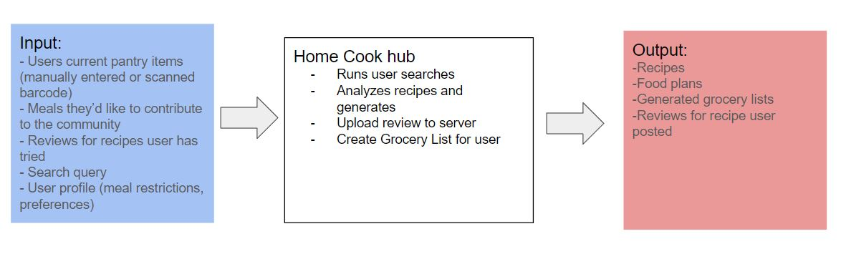
Design Diagrams
Notes:
John

Slide 7
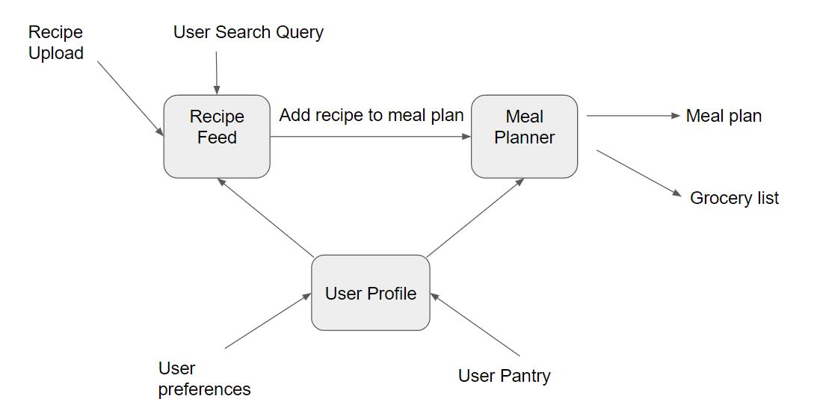
Design Diagrams
Notes:
John

Slide 8
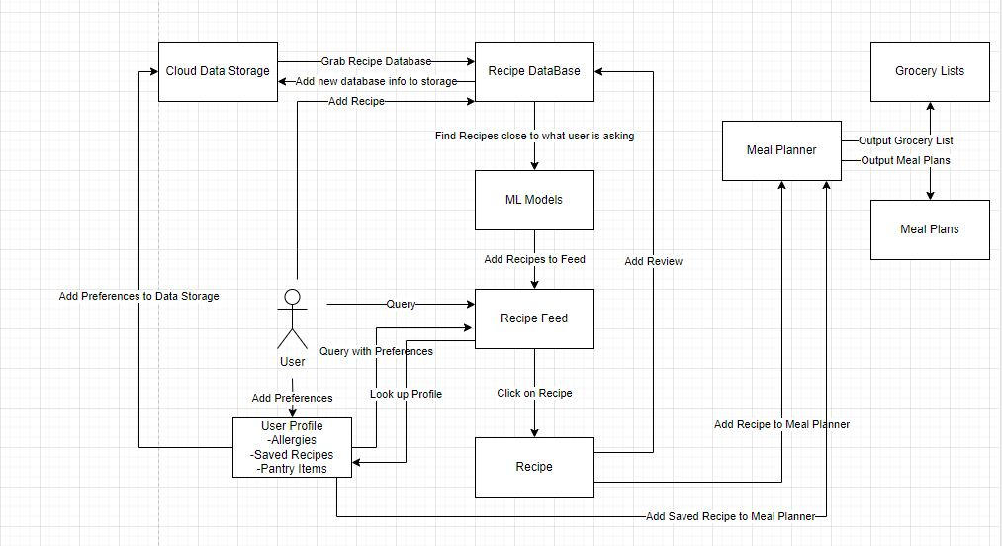
Design Diagrams
Notes:
John

Slide 9
Project Constraints
Security:
Ensure Data Security
Ensure what is private information remains private
Social:
Users can share meals/meal plans with each other as well as rate and review recipes
Makes planning meals less time consuming giving users more time to spend with family/friends
Legal:
Ensure that any of the recipes does not infringe on copyright
Follow terms of service of all software used for the project
Cultural/Diversity:
App will be primarily in English
Support upload of diverse recipes from foreign cultures
Notes:
Sarah

Slide 10
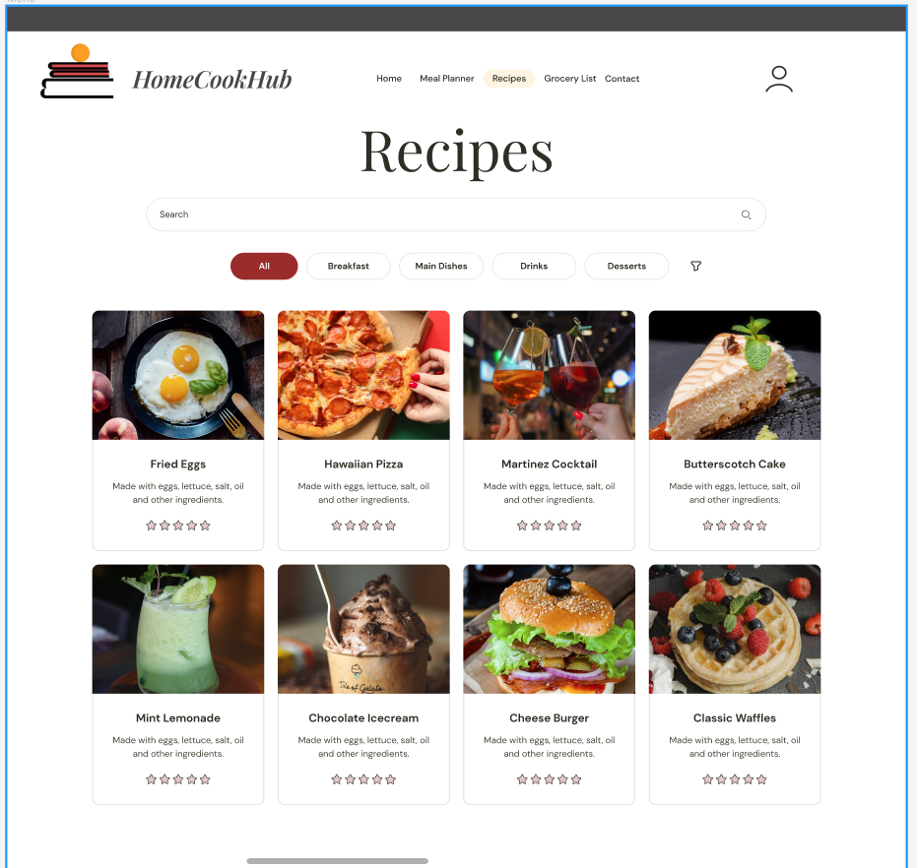
Project Progress - Frontend
Planning and goals
Barebones figma UI design
Learned some of the necessary languages/tools such as React and Figma
Notes:
Sarah

Slide 11
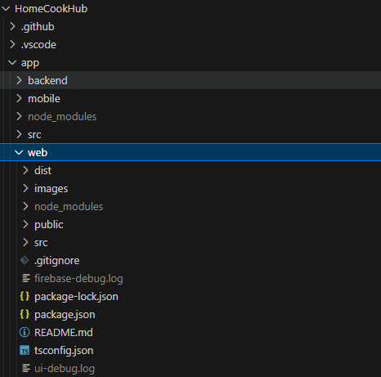
Project Progress - Backend
Learned some of the necessary languages/tools such as Node.js, Firebase and Express JS
Setup of base environment
Added in Authentication for Users
Database Design for Users and Recipes
Notes:
Mary

Slide 12
Who’s doing what
Sarah: Frontend Development
Preston: Mobile Integration
John: Backend Development
Mary: Backend Development
Notes:
Mary

Slide 13
Expected Accomplishments
Basic Frontend and Backend implementation on Web and Mobile
Test Database
Search function and viewing recipes
Basic Profiles/Login
Notes:
Mary

Slide 14
Expected Demo
Meal Planner
Searching for recipes
Saving recipes
Generatorating Grocery lists
Calendar
Polished UI design that is uniform and clean
Notes:
Mary

